Slide 1

Welcome to Year 5

Slide 2
What will you discover about Year 5 during this meeting?
Meet the team
Daily timetable
Curriculum
Trips and visits
Inclusion

Slide 3
Meet the team
Mrs. Hazel – Class Teacher
Mr Stead – Class Teacher
Mrs Le Chevalier – Class Teacher (English and Maths)
Mrs. Wilson – Teaching Assistant
Mr Alcock - Teaching Assistant

Slide 4
Gorsemoor Expectations
Start of the day
  The gates will open at 8:40am and will close at 8:55am. If you arrive once the gate is closed, please bring your child into school through the front office and sign them in using the automated system.
End of the day
  Gates will open at 3:20pm. You will be allowed on to the playground at 3:30pm and follow the one-way system to collect your child.
  We will bring children up to the office at 3:40pm if they have not been collected.
  If you need to make a late change to your collection arrangements, please let the class teacher know as well as the office.
  If someone different will be collecting your child, please contact the office.
Walkers
  From Year 5, children can walk home with permission from their parents/carers.
  We already have a lot of children walking in Year 5.
  If you would like your child to begin walking home later in the year, the Google Form can still be filled out to give permission.

Slide 5
Gorsemoor Expectations
School Uniform
PE Kit
  Burgundy jumper or cardigan
  White polo shirt or open collared shirt
  Grey trousers or skirt
  Grey Socks or tights
  Black school shoes (trainers and heeled shoes are not allowed)
  Trainers with a grip sole
  White t-shirt
  Burgundy shorts
  Black tracksuit bottoms
  Black tracksuit jacket or jumper

Slide 6
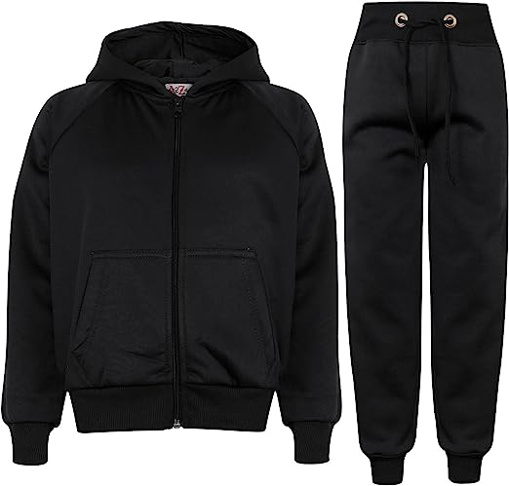

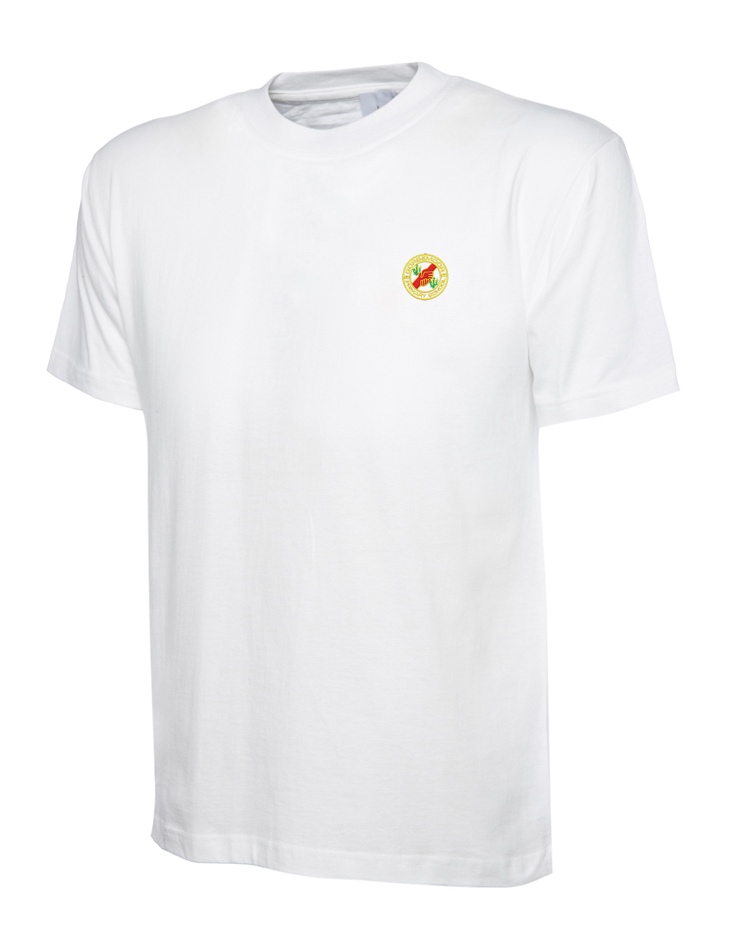
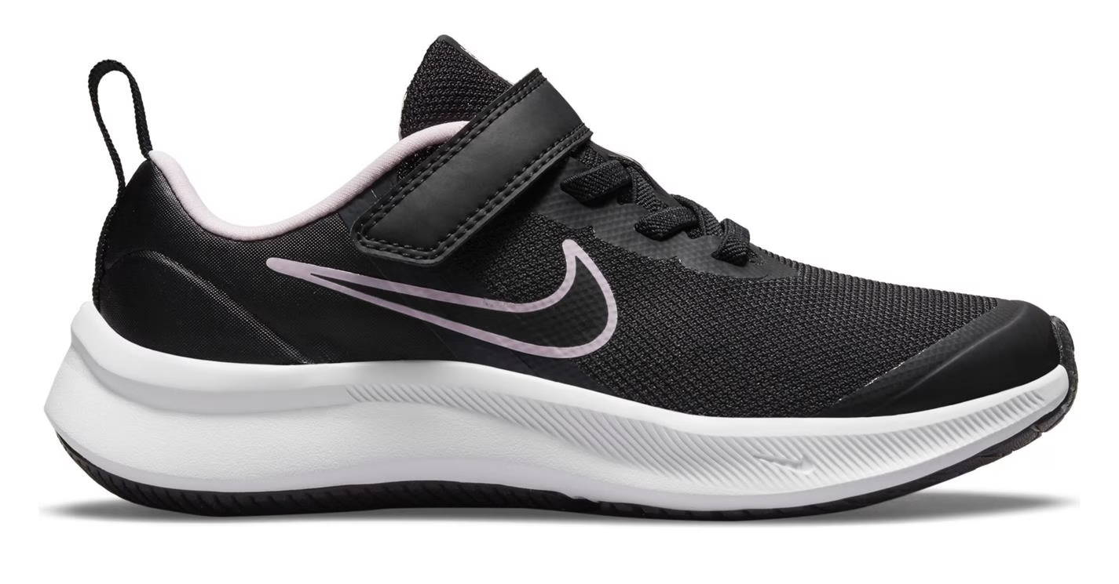
PE Kit

Slide 7
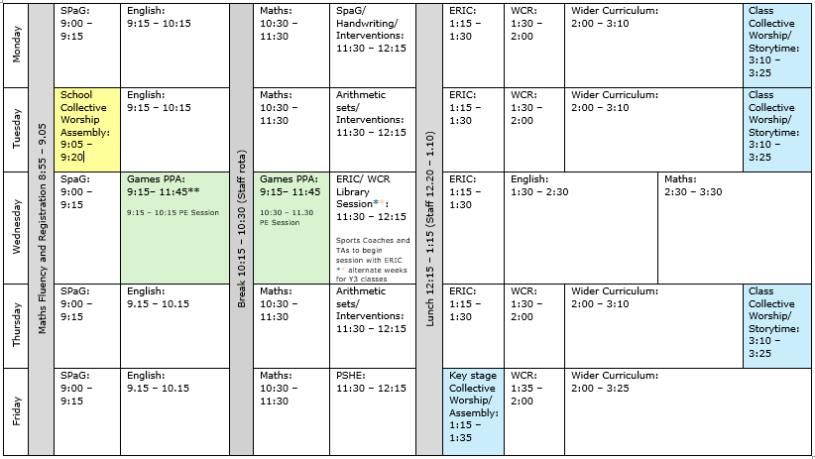
Class Timetable

Slide 8
Key days through the week
Wednesdays – Coach-led PE for indoor and outdoor sessions. Children to come to school in their PE kit.
Preferably earrings need to be removed prior to PE sessions. In some circumstances they can be covered by tape, but this must be done at home before coming to school.
Wednesdays – Spelling quiz to be completed and new spellings given out.
Wednesdays – Home reading books will be changed
Fridays - reading diaries will be stamped and house points for those children who read 3+ times will be added onto Class Dojo.

Slide 9

Curriculum in Year 5 – Reading Journey

Slide 10

Reading at Home
Children are encouraged to read daily at home. We know that regular reading has a huge impact on academic progress across all subjects.
Pupils will be given a reading book matched to their reading level according to the National Book Bands. Teachers regularly assess pupils against these bands and aim to move them up to bands accordingly.
Pupils will progress through the colours at their own pace. Understanding what they are reading is as important as the fluency, especially once pupils reach brown band and above.
Reading for pleasure is encouraged! This could be magazines, high-quality online reading material, audiobooks or being read to. This can be logged in reading diaries as well.

Slide 11

Reading Diaries
Children are encouraged to read daily at home. We know that regular reading has a huge impact on academic progress across all subjects.
Children will be given a new reading diary this year. They need to log when they have read at home at least 3x a week. Older children can do this themselves, but we ask that parents still check in with the reading diaries and sign them regularly.
These will be checked by class teachers weekly and stamped. Children earn a house point for 3 entries per week. The reading diaries also provide opportunities for parent – school communication about reading so please feel free to write in them alongside your child.

Slide 12
School Library
All pupils access our school library at least once per week.
Pupils use the space to read for pleasure and also take part in group story times and activities.
Pupils in Year 3 and above have their own library card and can borrow 1 book from the school library. Class librarians help pupils to borrow and return these books during their library slot every 2 weeks. Please can they be kept in school bags so they are available to read from during daily ERIC(everybody reads in class) time.

Slide 13

Handwriting
We are launching a whole school focus on mastering fundamental letter formation skills and improving handwriting and presentation.
All pupils have started the year using pencil.
In EYFS and KS1 we use the PenPals Handwriting Programme to teach letter formation using interactive resources. It focuses on developing gross and fine motor skills in fun ways, leading to written letter and number formation.
From Year 3 onwards we begin to teach pupils to join their letters using Letterjoin. This has home access for pupils in Year 3 and 4 and log ins will be given out shortly.
Pupils from Year 4 upwards will be able to earn their Pen Licence and will be celebrated in assembly on a Friday. We have purchased high quality handwriting pens for pupils to use once they have achieved their pen licence.

Slide 14


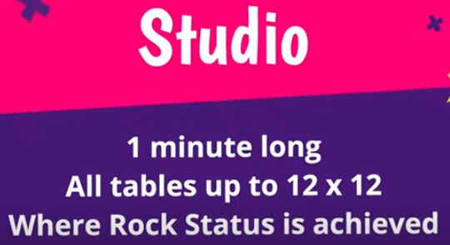
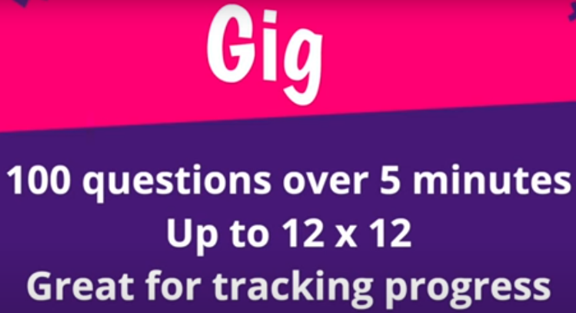

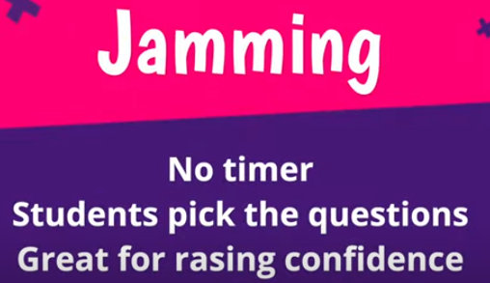
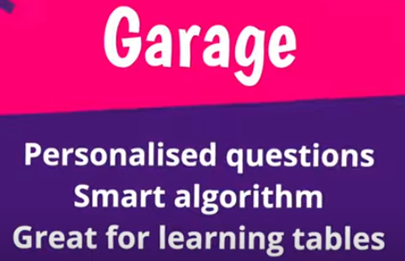
Times Table Rock Stars
Login details have been reissued.
Children will play on TTRS at least once per week in school.
We encourage children to access TTRS regularly at home to develop their number fluency and rapid recall of multiplication and division facts.
The TTRS celebration board within the KS2 corridor recognises and celebrates when children move to a new rock status!
Certificates awarded regularly (Heat Map, Most Improved in Accuracy, Most Correct Answers)
TTRS and NumBot Day FRIDAY 27th NOVEMBER 2026.

Slide 15


Slide 16

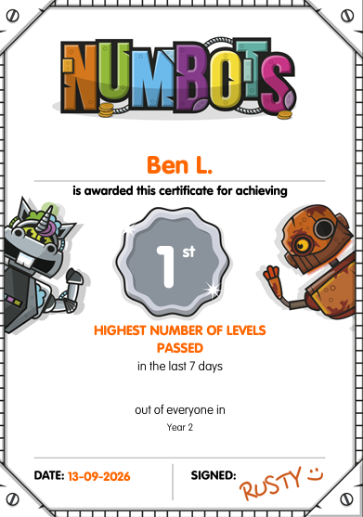

NumBots
Login details will be reissued.
Children will play on NumBots at least once per week in school.
We encourage children to access NumBots regularly at home to develop their number fluency.
Certificates awarded regularly in Friday’s celebration assembly (Stage Certificates, Most Improved in Accuracy, Highest Number of Levels Passed)
TTRS and NumBot Day FRIDAY 27th NOVEMBER 2026.

Slide 17


Slide 18

Morning Maths!
To support children with their number fact fluency and confidence in Maths, each morning they will access a short low-stakes task during registration time.
The children may practice skills such as number bonds, doubles, halves, multiplication or division facts.
Children will access NumBots or TTRS at least once per week in this session.
Morning learning will be adapted as necessary.

Slide 19
Trips and Visits
As a school, we enjoy exploring our local environment. Annual permission for local walks will be collected in order to complete these walks.
Each year group will attend at least one trip during the school year. As these are not yet planned, they will be shared in sufficient time.
Extra curricular activities at school (choir/sports) do provide some children with the opportunity to attend external events.
We will be performing an Easter Performance towards the end of the Spring term (WC 22/3/27). Times and dates will be shared closer to the time.

Slide 20
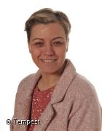
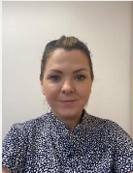
Inclusion Support
Inclusion Leader
Mrs Porter
Family and Multi-Agency Liaison Officer
Mrs Walton

Slide 21
Any questions?

