Slide 1






















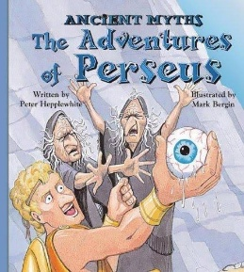










6
6
7
SATs Practice
SATs Practice
History

